Slide 1
IBM Applied Data Science Capstone Project
Battle of the Neighborhoods

Slide 2
Approach
Identify the data set – Foursquare
Understand the data
Collect the data
Preprocess the data
Prepare the data
Modelling
Analyze the output
Prepare final summary

Slide 3
Final Output
Identify the clusters of boroughs in New York neighborhood that has the Indian restaurant's rated >8.0

Slide 4
Data & Approach
Collect FourSquare Location data for NY – key elements includes name, neighborhood, borough, longitude, latitude etc
Prepare neighborhood list, map to borough, identify restaurants rated 8.0 & higher,
Review the data, output at each step, visualize
Pre-process the data
Cluster the data (K-Means, K=6)
Review output
Visualize the output

Slide 5
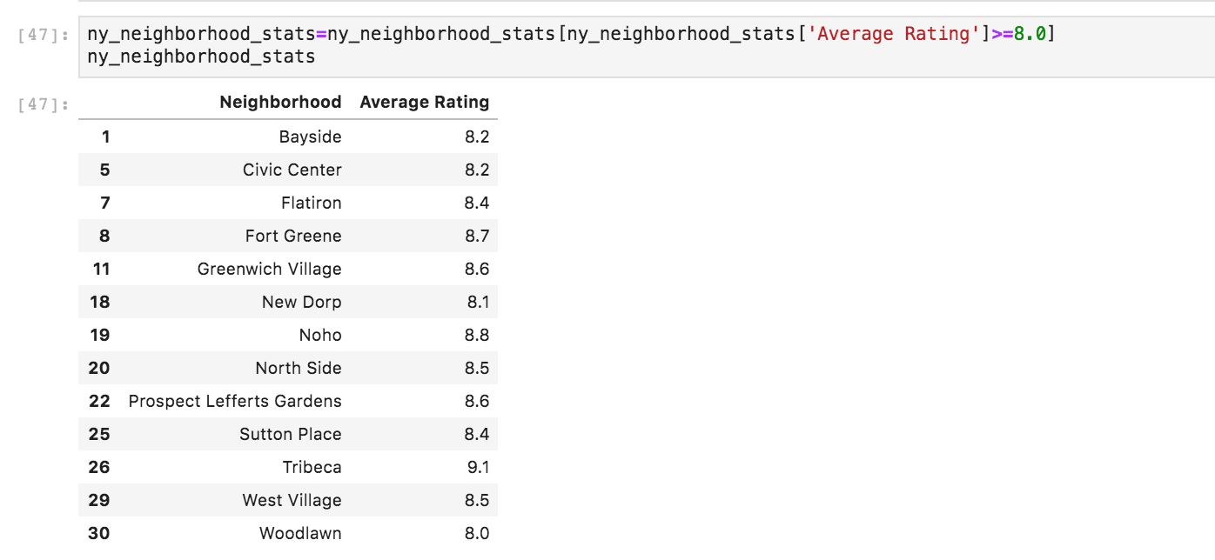
Identify neighborhoods with restaurants rated 8.0 & higher

Slide 6
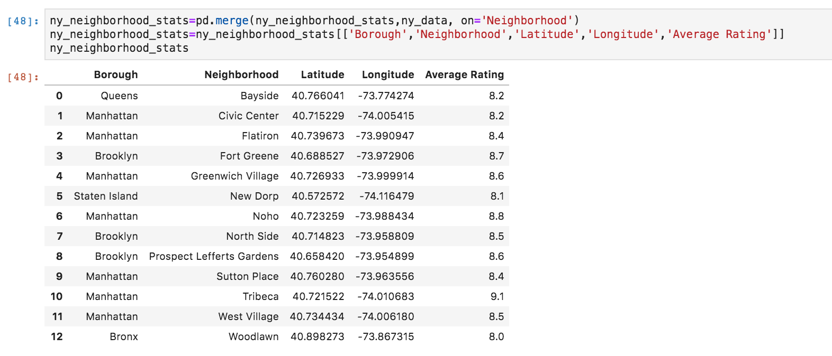
Map data to NY borough’, get other key data

Slide 7
Map data to NY borough’, get other key data

Slide 8
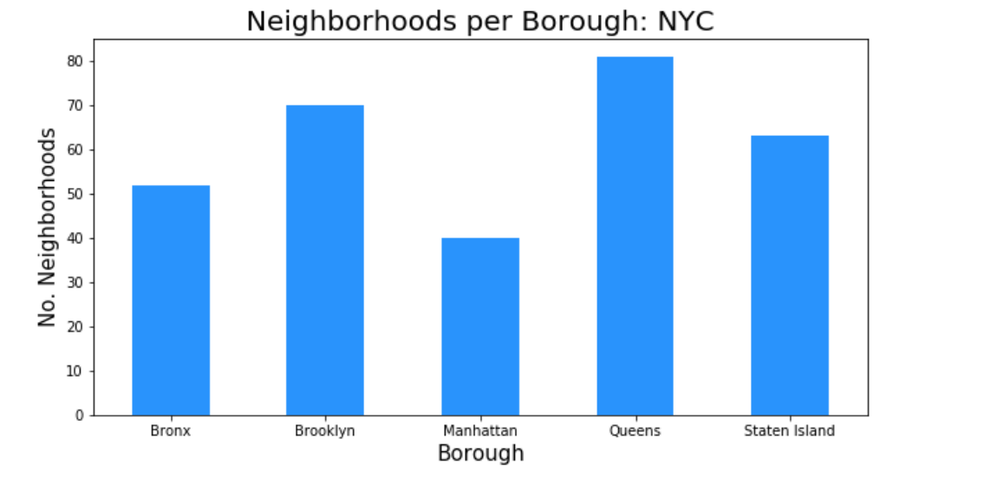
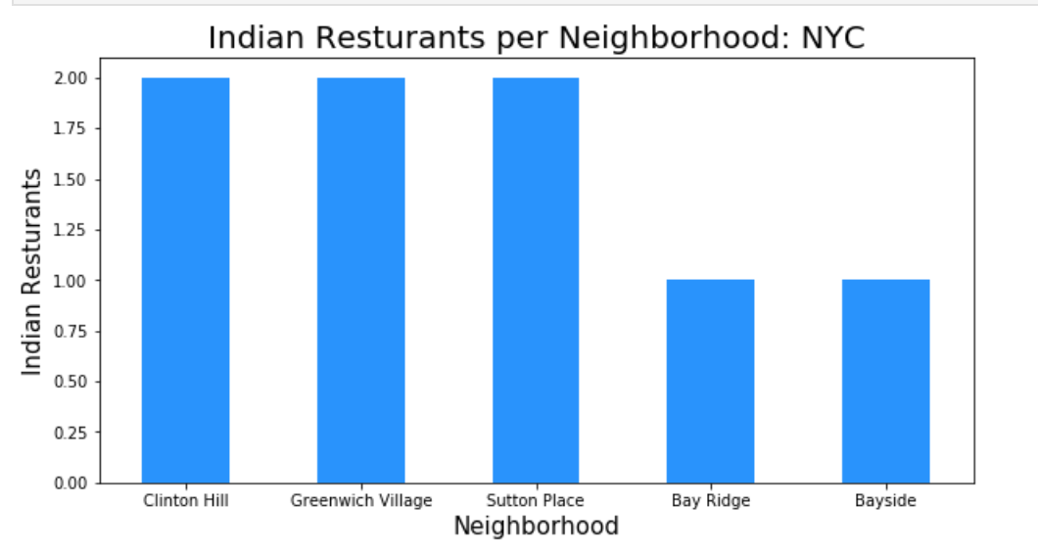
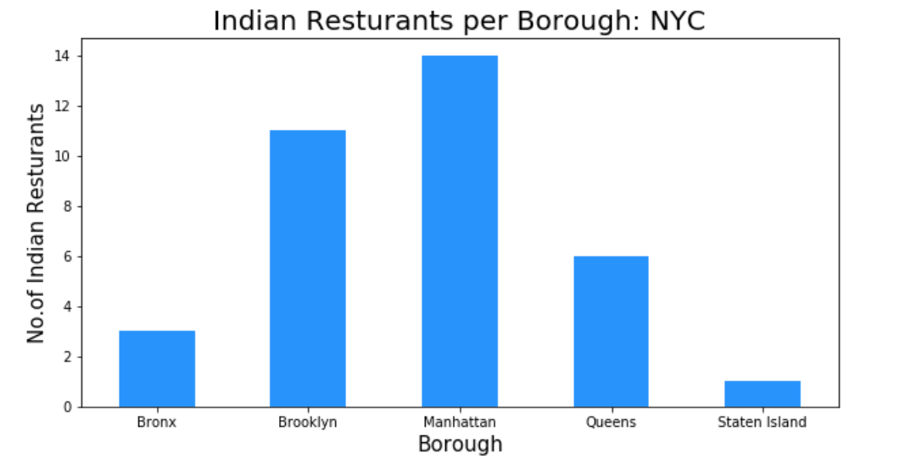
Visualize

Slide 9
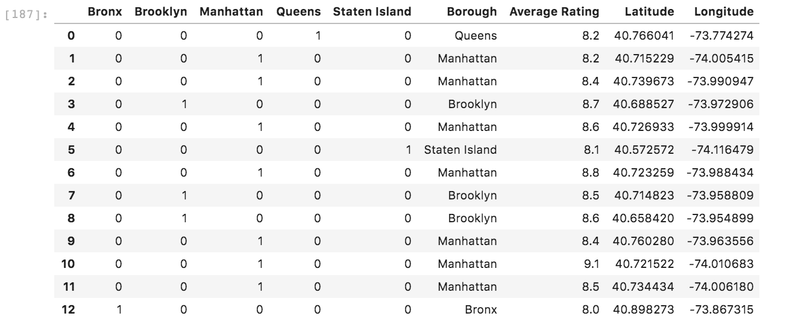
Prepare Data

Slide 10
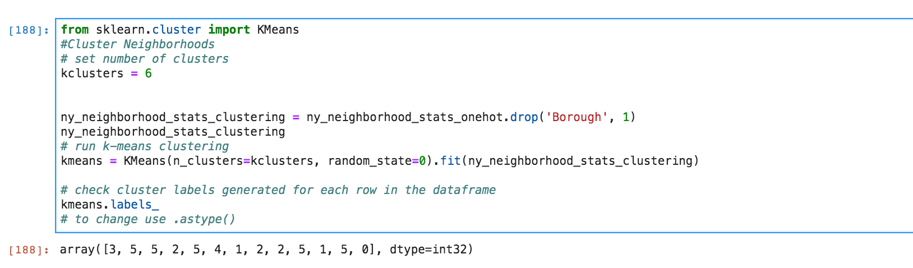
Cluster Data

